Slide 1
On the move for a good time!
Team
Eric Bezzam (@ebezzam)
Shiyue Nie (@nnnsyyy)
Weiyu Zhang (@BeforeRain)

Slide 2
Behavior/Mobility Pattern
Geo-located information analysis
Text-based/Content-based analysis
Hybrid analysis
Individual: Space-time trajectory
Group: Cluster/Classification (e.g. DBSCAN)

Slide 3
Inner Movement in Switzerland
Majority data in Switzerland (CH)
Easy to distinguish in cantons
Convenient train/transport network
Individual (daily) trace
Visualization in canton map
Most popular canton/routine

Slide 4
Framework of model
Data-preprocessing: Extract geo-location (state) and time (year, month, week, day, hour etc.)
Space-time Twitter user trajectories: Tuple each Twitter as <userId, loc(latitude and longitude), time> and filter valid movement (in reasonable speed)
Trace extraction: Sorted in time order, figure out (daily) trace of each user, selecting different locations continuously (regardless of inner-canton movement)
Visualization in CH canton map

Slide 5
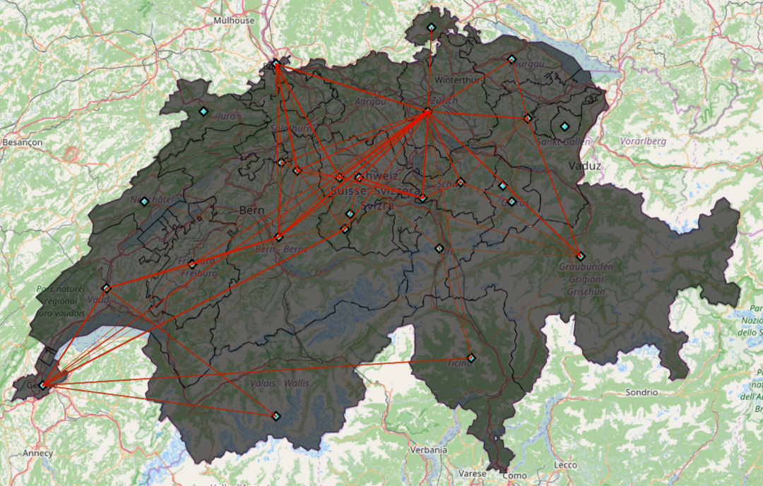
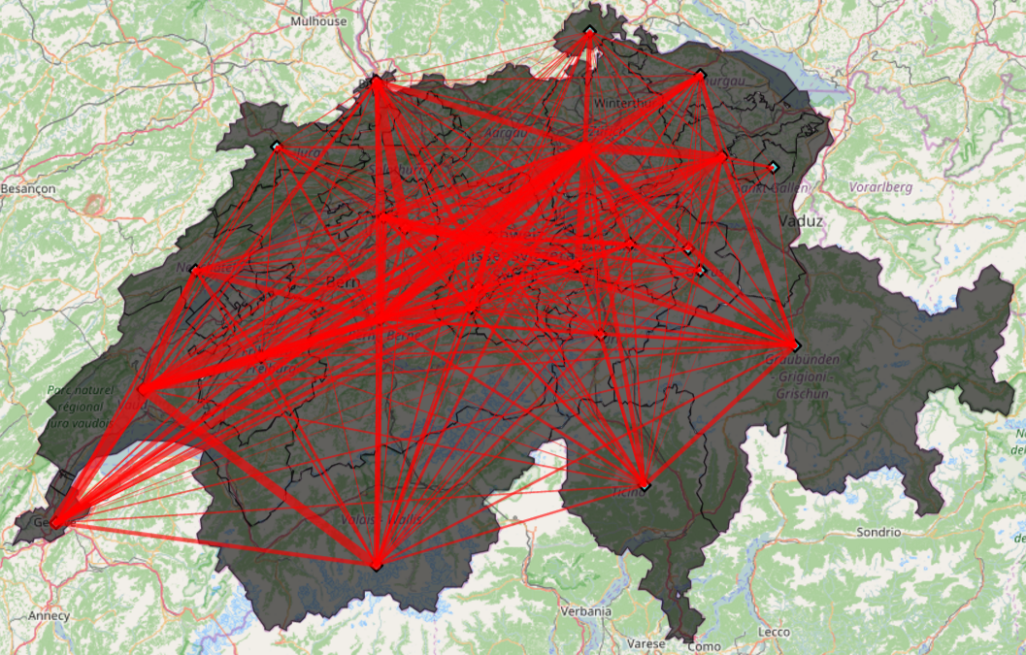
Partial Result
All ‘daily’ traces: accumulate all trips in one day
Map 1: Partial data (1/500)
Map 2: All data (Over 10 trips)

